Slide 1
REPORT
BUG NAME :out-of-date version(Tomcat)
DOMAIN :webappsecurity.com
SUBDOMAIN :zero.webappsecurity.com
DESCRIPTION
With the help of NetSparker we found the critical automatic vulnerability.web application security
Scanner that enables you to scan websites,web applications and web servicesand identify security flaws.
PROCEDURE
Step 1:Include http://zero.webappsecurity.com/ in the website
Step 2:change the custom option to scan vulnerabilities
Step 3:it gets starts scanning
Step 4:then I found there are 3 critical vulnerabilities.From that I have choosen out-of-date version
IMPACT
A vulnerability rated with acritical impact is one which could potentially be exploited by a remote
Attackerto get Tomcat to execute arbitary code.since it is old version it can be easily attacked.

Slide 2
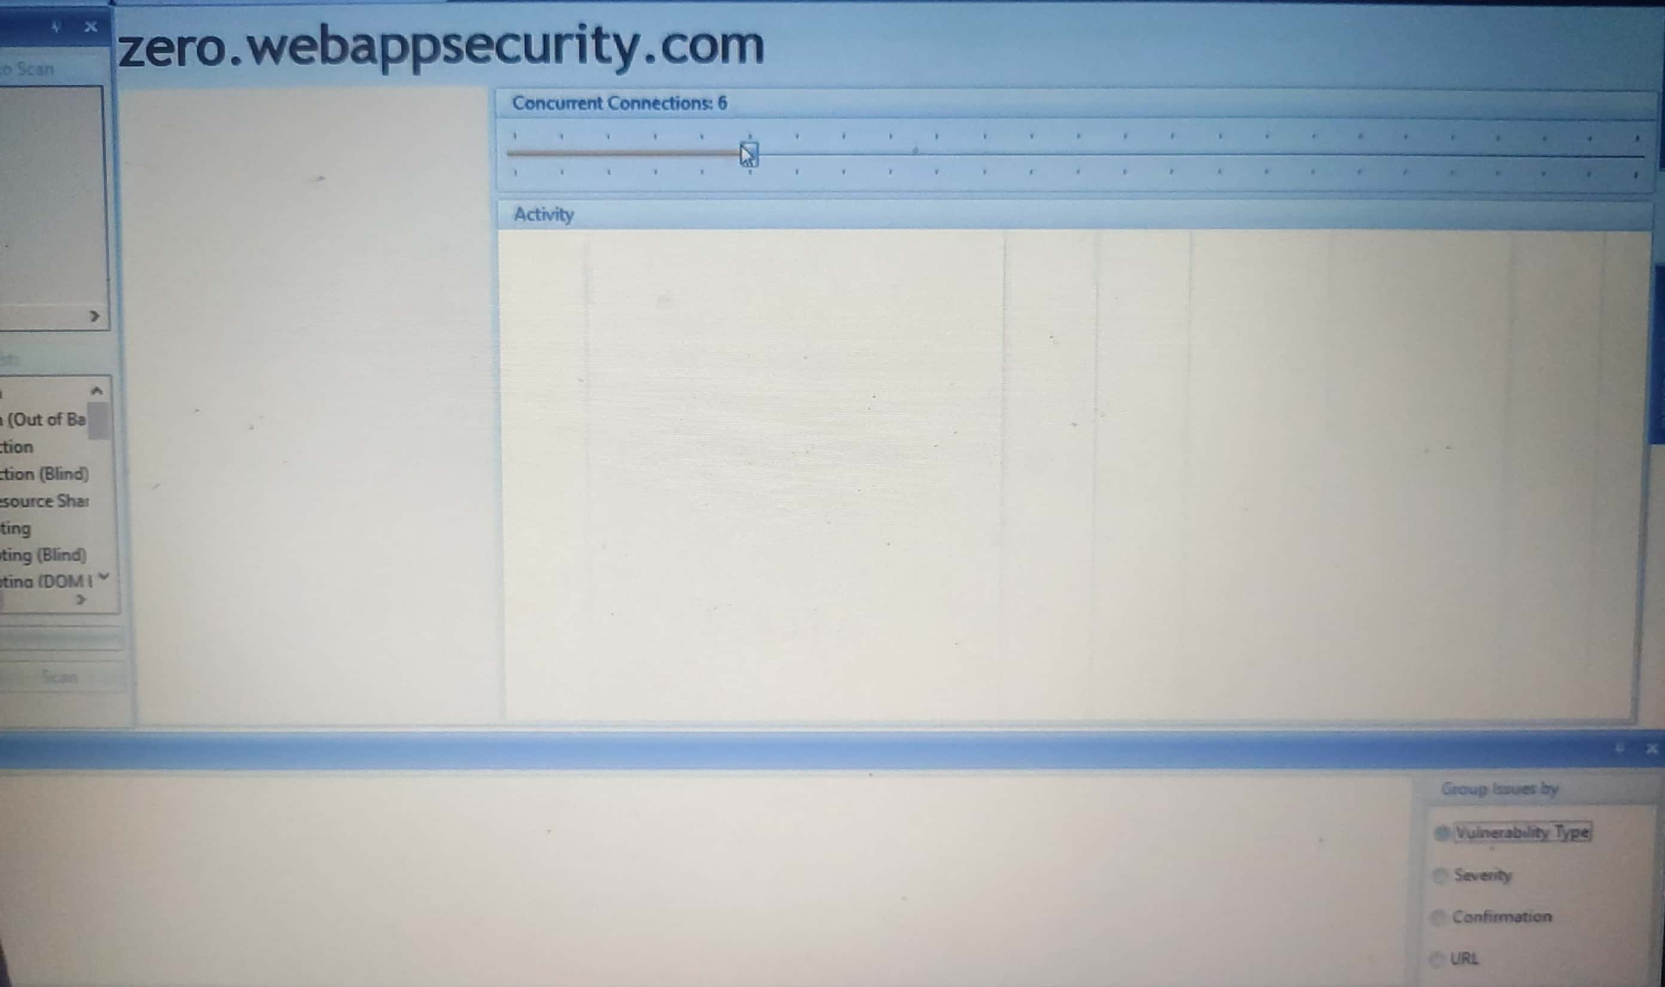

Slide 3
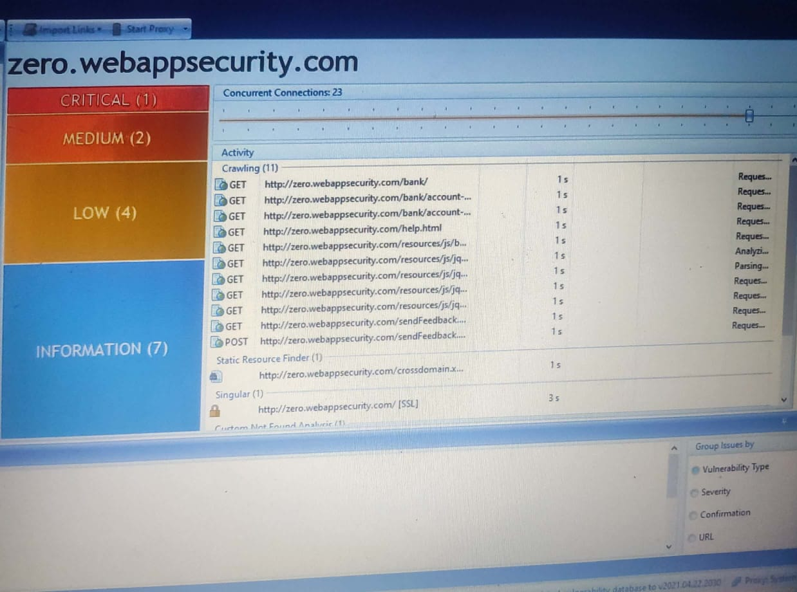

Slide 4
